Slide 1
Data Mining & Warehousing
By
Prof. Dr. O.P.Vyas
DAAD Fellow (Germany), AOTS Fellow(Japan)
Indian Institute of Information Technology, Allahabad

Slide 2
D.M.W.
Data Mining
  Overview of Data Engineering
    RDBMS, Multi Dimensional Databases, OLAP, Data Warehouse
  DM: Overview of Techniques
    Algorithms & Implementations
  Data Mining tools & D2K: Software Engineering
  Association Rule Mining: Apriori Algorithm
  Classification & Predictive mechanism
  Clustering Analysis
  Issues in DM : User-Centric Vs Procedure centric
    Utility Mining issues
    Rare item Problem:Single MinSup problem
B.I. : Business Intelligence
  Business Intelligence
  Business Planning & Forecasting Technologies
  Computational Knowledge Discovery
  Association Rules Vs. Business Rules.
  Companies using Business Intelligence
    Master Card, Wall Mart, Burger King,
Social Network Analysis & Data Mining

Slide 3
Data Mining
Implementation & Projects
Since 1995, many data mining conferences and portals with tools and datasets have made Data Mining develop as prime area of interest to Academia & Industry both.
ACM SIGKDD Conference on Knowledge Discovery and Data Mining (KDD) - since 1995 was the platform for many new algorithms and approaches.
The dataset plays very significant role in Data Mining and thus many open source repositores are functional for various implementation with R&D in the related domains

Slide 4
UCI KDD Archive
http://kdd.ics.uci.edu
This is an online repository of large data sets which encompasses a wide variety of data types, analysis tasks, and application areas.
The primary role of this repository is to enable researchers in knowledge discovery and data mining to scale existing and future data analysis algorithms to very large and complex data sets.
. The archive is intended to serve as a permanent repository of publicly-accessible data sets for research in KDD and data mining. It complements the original UCI Machine Learning Archive , which typically focuses on smaller classification-oriented data sets.
Notes:
Ranjana vyas

Slide 5

Kaggle:
Home for Data Science
Kaggle is an online community of data scientists and machine learners, offering data mining professionals an open platform
Kaggle allows users to find and publish data sets, explore and build models in a web-based data-science environment, work with other data scientists and machine learning engineers, and enter competitions.
Kaggle is a platform for predictive and analytics competitions in which statisticians and data miners compete to produce the best models for predicting and describing the datasets uploaded by companies and users.
  Work crowdsourcing approach relies on the fact that there are countless strategies that can be applied to any predictive modelling task

Slide 6
Kaggle got its start by offering machine learning competitions to solve data science challenges and now also offers a public data platform, a cloud-based workbench for data science, and short form AI education.
On 8 March 2017, Google announced that they were acquiring Kaggle.
Though many believed that the original Kaggle died the day kernels were introduced. Kaggle is signifiacnt for two main reasons: Learning data mining, and the competitive framework.

Slide 7
ARM: Apriori & Beyond
ARM begun with Apriori Algorithm but the algorithmic analyses suggested issues.
Many modifications kept coming in Apriori approach resulting many frequent pattern based approaches..

Slide 8
Goal and key features
Goal: Find all rules that satisfy the user-specified minimum support (minsup) and minimum confidence (minconf).
Key Features
  Completeness: find all rules.
  No target item(s) on the right-hand-side
  Mining with data on hard disk (not in memory)
CS583, Bing Liu, UIC

Slide 9
An example
  t1: Beef, Chicken, Milk
  t2: Beef, Cheese
  t3: Cheese, Boots
  t4: Beef, Chicken, Cheese
  t5: Beef, Chicken, Clothes, Cheese, Milk
  t6: Chicken, Clothes, Milk
  t7: Chicken, Milk, Clothes
Transaction data
Assume:
minsup = 30%
minconf = 80%
An example frequent itemset:
{Chicken, Clothes, Milk} [sup = 3/7]
Association rules from the itemset:
Clothes → Milk, Chicken [sup = 3/7, conf = 3/3]
… …
Clothes, Chicken → Milk, [sup = 3/7, conf = 3/3]
CS583, Bing Liu, UIC

Slide 10
The Apriori Algorithm
Join Step: C_{k} is generated by joining L_{k-1}with itself
Prune Step: Any (k-1)-itemset that is not frequent cannot be a subset of a frequent k-itemset
Pseudo-code:
    C_{k}: Candidate itemset of size k
    L_{k} : frequent itemset of size k
    L₁ = {frequent items};
    for (k = 1; L_{k} !=∅; k++) do begin
    C_{k+1} = candidates generated from L_{k};
    for each transaction t in database do
      increment the count of all candidates in C_{k+1} that are contained in t
    L_{k+1} = candidates in C_{k+1} with min_support
    end
    return ∪_{k} L_{k};
Notes:
Ranjana vyas

Slide 11
Association Rule Mining : Mining Frequent Itemsets
ARM is a two step process ;
1. Find the frequent itemsets: the sets of items that have minimum support
  A subset of a frequent itemset must also be a frequent itemset
    i.e., if {AB} is a frequent itemset, both {A} and {B} should be a frequent itemset
  Iteratively find frequent itemsets with cardinality from 1 to k (k- itemset)
2. Use the frequent itemsets to generate association rules. ( as these rules will satisfy minimum support and minimum confidence)
Notes:
Ranjana vyas

Slide 12








The Apriori Algorithm — Example
Database D
L₁
C₁
Scan D
C₂
C₂
L₂
Scan D
C₃
Scan D
L₃
Notes:
Ranjana vyas

Slide 13
On Apriori Algorithm
Seems to be very expensive with features like
Level-wise search
K = the size of the largest itemset
It makes at most K passes over data
In practice, K is bounded (10).
The algorithm is very fast. Under some conditions, all rules can be found in linear time.
Scale up to large data sets
Clearly the space of all association rules is exponential, O(2^{m}), where m is the number of items in I.
The mining exploits sparseness of data, and high minimum support and high minimum confidence values.
Still, it always produces a huge number of rules, thousands, tens of thousands, millions, ...
Notes:
Ranjana vyas

Slide 14
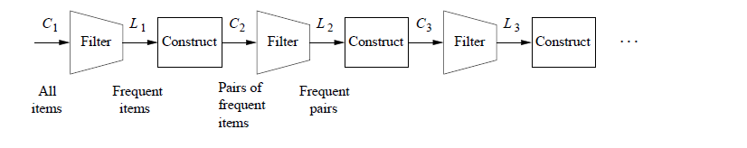
Pros of the Apriori algorithm
  It is an easy-to-implement and easy-to-understand algorithm.
  It can be used on large itemsets.
Cons of the Apriori Algorithm
  Sometimes, it may need to find a large number of candidate rules which can be computationally expensive.
  Calculating support is also expensive because it has to go through the entire database.

Slide 15
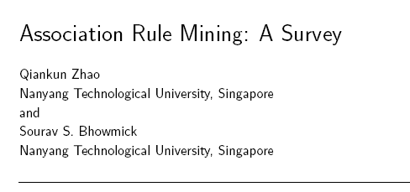
Many ARM algorithms
There are a large number of them!!
They use different strategies and data structures.
Their resulting sets of rules are all the same.
  Given a transaction data set T, and a minimum support and a minimum confident, the set of association rules existing in T is uniquely determined.
Any algorithm should find the same set of rules although their computational efficiencies and memory requirements may be different. We study only one: the Apriori Algorithm
Notes:
Ranjana vyas

Slide 16
Apriori & FP Tree
Apriori though became instantly popular with many applications like MBA (Market Basket Analysis) but major performance bottlenecks surfaced due its working mechanism…
FP tree growth is one popular approach which improves upon the Apriori.

Slide 17
ARM: Apriori & FP
Apriori though is the pioneer in generating frequent itemsets and thus Association rules, but suffers in performance.
Needs minsup and minconf to be specified in advance.
The Candidate set generation C in Apriori is expensive and causes major bottleneck when the itemsets are large.
  Number of Database scans will be high.
  High search space is required.
Some variants like AprioriTid avoids Number of Database scans but Candidate set generation problem remains.
FP generates frequent itemsets without candidate set generation thus more efficient.
Needs minsup and minconf to be specified in advance.
Conditional Frequent Pattern tree is generated rather than Candidate set generation
The number of Database scans are very less (generally only two scans are sufficient)
Recursive mining of conditional FP Tree is done and complete but compact tree is generated.
Apriori & FP Tree both generate same set of results but FP proves to be more efficient in general.

Slide 18
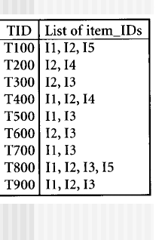
FP -Growth
The first scan of the database in same as Apriori which derives frequent and counts the support. Let minimum support be 2
L= {(I2,7)}
{I1:6}
{I3:6}
{I4:2}
{I5:2}

Slide 19
First create the root of the tree ,labeled “null ” scan database D a second time.
Items in each trans. are proceed in L order(sorting in desc order)and branch is created for each transaction.
Ex.Scan of first Transaction, ”T 100:I1,I2,I5” CONTAINS THREE ITEMS L order, leads to construction of First branch of the tree with three nodes.
I2 IS linked as child to the root,I1 IS LINKED TO I2 & I5 is linked to I1.
SECOND Transaction T200,Contains the items I2 AND I4 IN L ORDERwhich would result in a branch where I2 IS LINKED to the root and I4 is linked to I2.
BRANCH SHARES A COMMON PREFIX I2 WITH existing path for T100.
INSTEAD OF INCREMENT THE COUNT OF THE I2 Node by 1,& create a new node (I4:1),WHICH IS LINKED AS A CHILD TO (I2:2) Count of each node is incremented by 1and nodes for the following the prefix are created and linked accordingly.
To facilitate tree traversal an item header tab;le is built so that each item points to its occurrence in the tree via chain of node-links

Slide 20
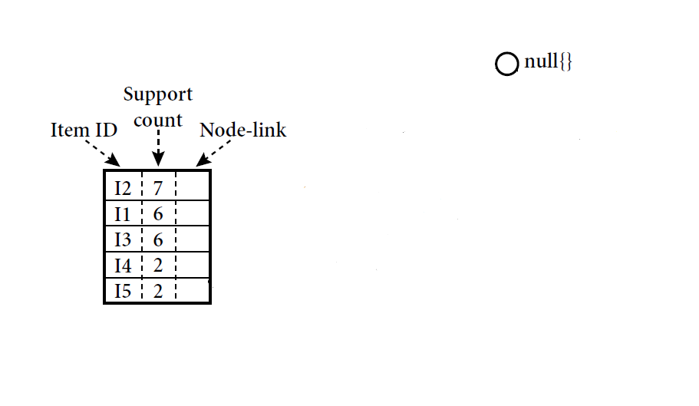
FP-Tree construction 1/6
Desc. supp. sort
Min support = 2
Ivan Tanasic (itanasic@gmail.com)
<number>/25

Slide 21
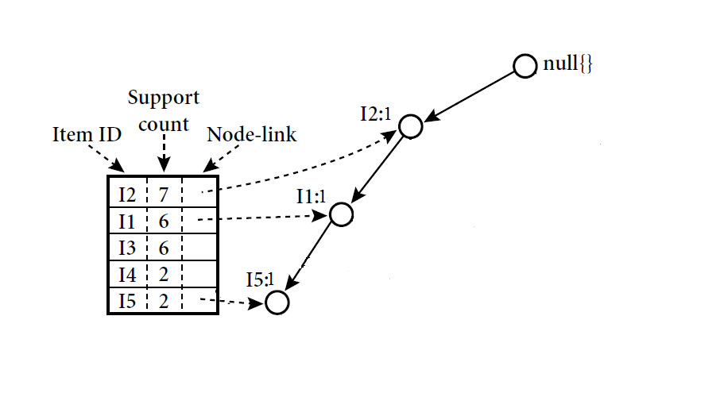
FP-Tree construction 2/6
First create the root of the tree ,labeled “null ” scan database D a second time.
Items in each trans.are proceeed in L order(sorting in desc order).
Desc. supp. sort
T1={I2,I1,I5}
Ivan Tanasic (itanasic@gmail.com)
<number>/25

Slide 22
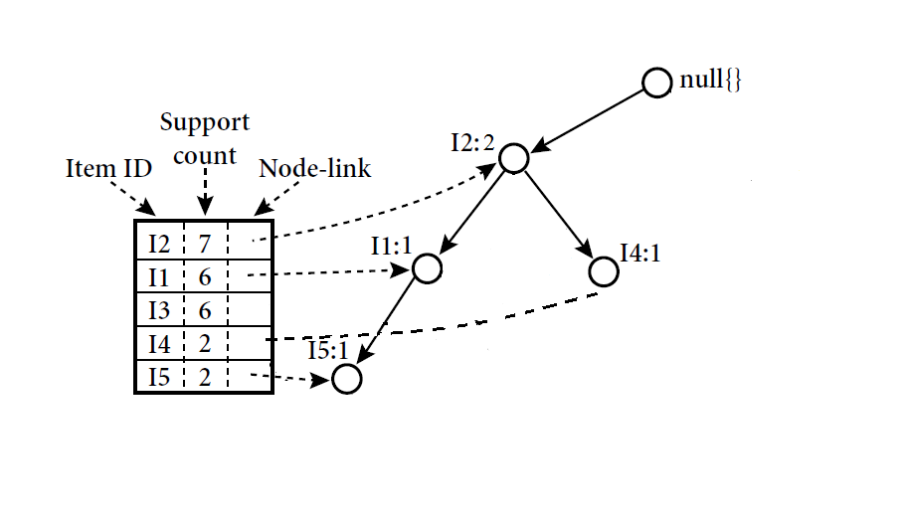
FP-Tree construction 3/6
1st first transaction,”T100:I1,I2,I5” contains three items(I2,I1,I5 IN L ORDER First branch of the tree with three nodes(I2:1),(I1:1)(I5:1)
(I2 IS linked as child to the root)
I1is linked to I2
I5 IS linked to I1
Desc. supp. sort
T1 = {I2, I1, I5}
T2 = {I2, I4}
Ivan Tanasic (itanasic@gmail.com)
<number>/25

Slide 23
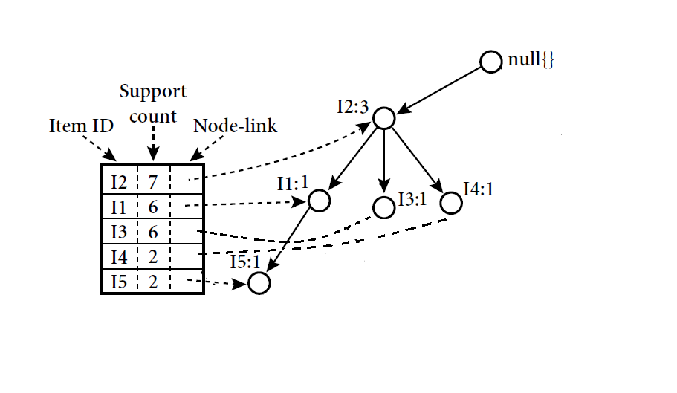
FP-Tree construction 4/6
2ND TRANSACTION
T200 {I2, I4} IN L ORDER
{I2 IS LINKED TO ROOT
I4 IS LINKED TO I2 (SHARES COMMON PREFIX I2 existing path for T100 SO INSTEAD )
Create new node I4:1 WHICH IS LINKED TO child node of I2:2.
The count of each node along common prefix is incremented by 1and nodes for the items following the prefix are created and linked accordingly
Desc. supp. sort
T1 = {I2, I1, I5}
T2 = {I2, I4}
T3 = {I2, I3}
Ivan Tanasic (itanasic@gmail.com)
<number>/25

Slide 24
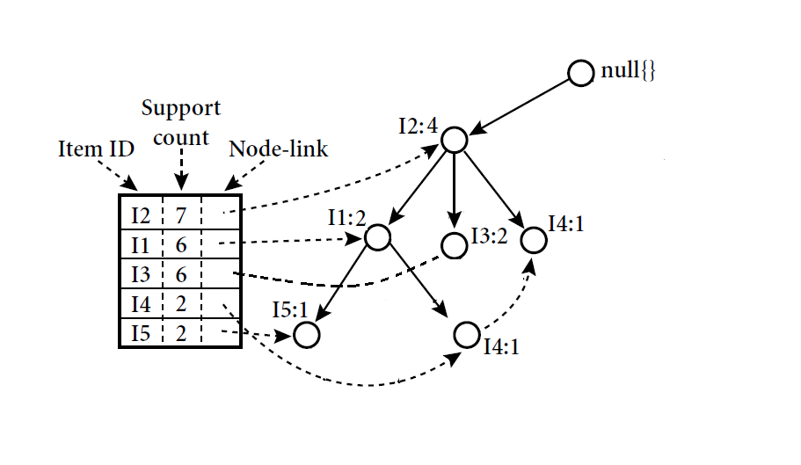
FP-Tree construction 5/6
Desc. supp. sort
T1 = {I2, I1, I5}
T2 = {I2, I4}
T3 = {I2, I3}
T4 = {I2, I1, I4}
Ivan Tanasic (itanasic@gmail.com)
<number>/25

Slide 25
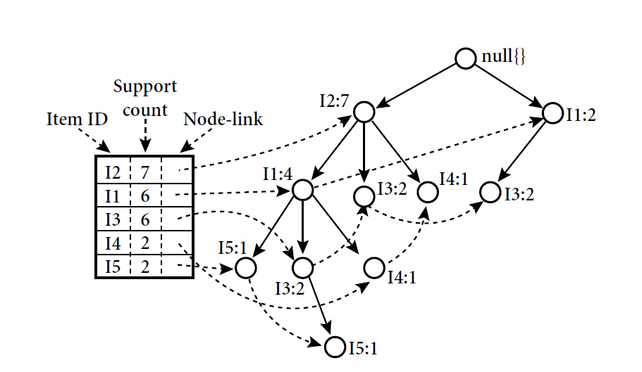
FP-Tree construction 6/6
Desc. supp. sort
T1 = {I2, I1, I5}
T2 = {I2, I4}
T3 = {I2, I3}
T4 = {I2, I1, I4}
T5 = {I1, I3}
T6 = {I2, I3}
T7 = {I1, I3}
T8 = {I2, I1, I3, I5}
T9 = {I2, I1, I3}
Ivan Tanasic (itanasic@gmail.com)
<number>/25

Slide 26
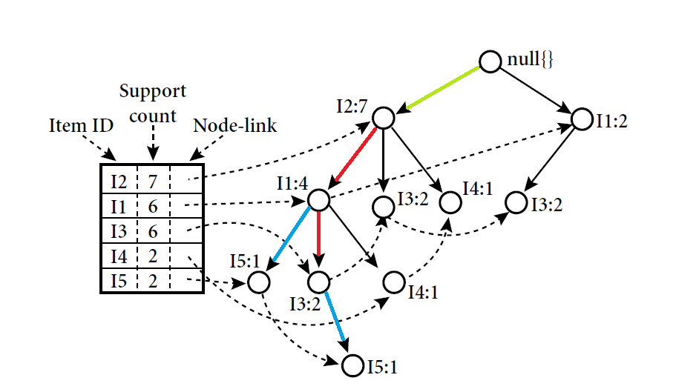
Mining of the FP-Tree 1/4
It. | Conditional P. base | Cond. FP-Tree | Freq. Patterns Generated
I5 | {{I2,I1:1},{I2,I1,I3:1}} | {I2:2, I1:2} | {I2,I5:2},{I1,I5:2},{I2,I1,I5:2}
Ivan Tanasic (itanasic@gmail.com)
<number>/25

Slide 27
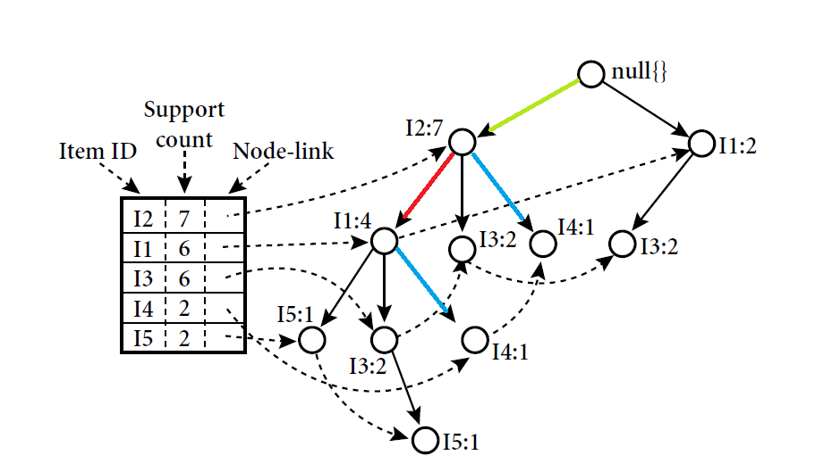
Mining of the FP-Tree 2/4
It. | Conditional P. base | Cond. FP-Tree | Freq. Patterns Generated
I5 | {{I2,I1:1},{I2,I1,I3:1}} | {I2:2, I1:2} | {I2,I5:2},{I1,I5:2},{I2,I1,I5:2}
I4 | {{I2,I1:1},{I2:1}} | {I2:2} | {I2,I4:2}
Ivan Tanasic (itanasic@gmail.com)
<number>/25

Slide 28
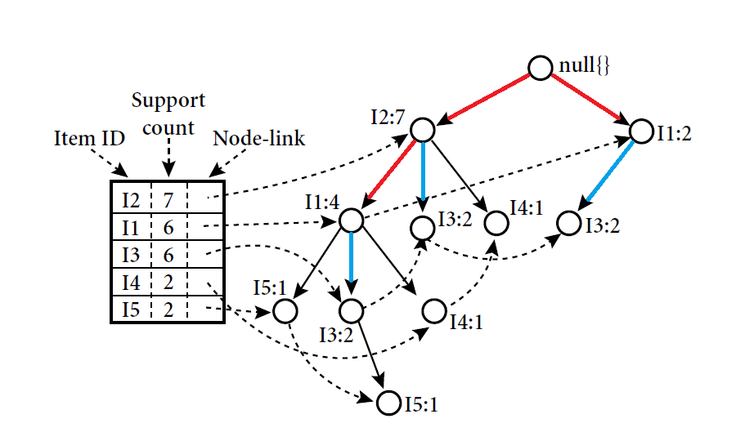
Mining of the FP-Tree 3/4
It. | Conditional P. base | Cond. FP-Tree | Freq. Patterns Generated
I5 | {{I2,I1:1},{I2,I1,I3:1}} | {I2:2, I1:2} | {I2,I5:2},{I1,I5:2},{I2,I1,I5:2}
I4 | {{I2,I1:1},{I2:1}} | {I2:2} | {I2,I4:2}
I3 | {{I2,I1:2},{I2:2},{I1:2}} | {I2:4,I1:2},{I1:2} | {I2,I3:4},{I1,I3:4},{I2,I1,I3:2}
Ivan Tanasic (itanasic@gmail.com)
<number>/25

Slide 29
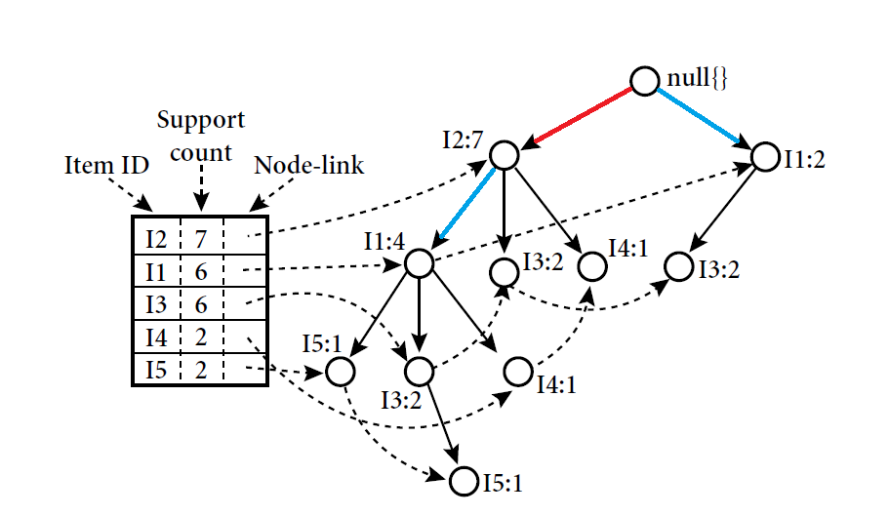
Mining of the FP-Tree 4/4
It. | Conditional P. base | Cond. FP-Tree | Freq. Patterns Generated
I5 | {{I2,I1:1},{I2,I1,I3:1}} | {I2:2, I1:2} | {I2,I5:2},{I1,I5:2},{I2,I1,I5:2}
I4 | {{I2,I1:1},{I2:1}} | {I2:2} | {I2,I4:2}
I3 | {{I2,I1:2},{I2:2},{I1:2} | {I2:4,I1:2},{I1:2} | {I2,I3:4},{I1,I3:4},{I2,I1,I3:2}
I1 | {{I2:4}} | {I2:4} | {I2,I1:4}
Ivan Tanasic (itanasic@gmail.com)
<number>/25

Slide 30
Apriori & FP Tree Comparison
Apriori though became instantly popular with many applications like MBA (Market Basket Analysis) but major performance bottlenecks surfaced due its working mechanism

Slide 31
ARM: Apriori & FP
Apriori though is the pioneer in generating frequent itemsets and thus Association rules, but suffers in performance.
Needs minsup and minconf to be specified in advance.
The Candidate set generation C in Apriori is expensive and causes major bottleneck when the itemsets are large.
  Number of Database scans will be high.
  High search space is required.
Some variants like AprioriTid avoids Number of Database scans but Candidate set generation problem remains.
FP generates frequent itemsets without candidate set generation thus more efficient.
Needs minsup and minconf to be specified in advance.
Conditional Frequent Pattern tree is generated rather than Candidate set generation
The number of Database scans are very less (generally only two scans are sufficient)
Recursive mining of conditional FP Tree is done and complete but compact tree is generated.
Apriori & FP Tree both generate same set of results but FP proves to be more efficient in general.

Slide 32
Apriori & FP Tree both serves the purpose of generating Association Rules and are in popular use in many applications.

Slide 33
ARM: Multi level

Slide 34
Mining Multiple-Level Association Rules
Items often form hierarchies
Flexible support settings
  Items at the lower level are expected to have lower support
Exploration of shared multi-level mining (Agrawal & Srikant@VLB’95, Han & Fu@VLDB’95)
uniform support
reduced support
Level 1
min_sup = 5%
Milk
[support = 10%]
Level 1
min_sup = 5%
Level 2
min_sup = 5%
2% Milk
[support = 6%]
Skim Milk
[support = 4%]
Level 2
min_sup = 3%

Slide 35
Multi-level Association: Flexible Support and Redundancy filtering
Flexible min-support thresholds: Some items are more valuable but less frequent
  Use non-uniform, group-based min-support
  E.g., {diamond, watch, camera}: 0.05%; {bread, milk}: 5%; …
Redundancy Filtering: Some rules may be redundant due to “ancestor” relationships between items
  milk ⇒ wheat bread [support = 8%, confidence = 70%]
  2% milk ⇒ wheat bread [support = 2%, confidence = 72%]
  The first rule is an ancestor of the second rule
A rule is redundant if its support is close to the “expected” value, based on the rule’s ancestor

Slide 36
A.R.M.: Road map
Basic concepts of Association Rule Mining
Apriori algorithm
  The model
  Rule strength measures
  Frequent itemset generation
Mining with user-defined inputs
Other A.R.M methods
A.R.M. Implementation websites
Notes:
Ranjana vyas

Slide 37
The Apriori Algorithm — Example
Database D
L₁
C₁
Scan D
C₂
C₂
L₂
Scan D
C₃
Scan D
L₃
Notes:
Ranjana vyas

Slide 38
Generating rules from frequent itemsets
Frequent itemsets ≠ association rules
One more step is needed to generate association rules
For each frequent itemset X,
For each proper nonempty subset A of X,
  Let B = X - A
  A → B is an association rule if
    Confidence(A → B) ≥ minconf,
    support(A → B) = support(A∪B) = support(X)
    confidence(A → B) = support(A ∪ B) / support(A)
Notes:
Ranjana vyas

Slide 39
Mining Multi-Dimensional Association
Single-dimensional rules:
    buys(X, “milk”) ⇒ buys(X, “bread”)
Multi-dimensional rules: ≥ 2 dimensions or predicates
  Inter-dimension assoc. rules (no repeated predicates)
    age(X,”19-25”) ∧ occupation(X,“student”) ⇒ buys(X, “coke”)
  hybrid-dimension assoc. rules (repeated predicates)
    age(X,”19-25”) ∧ buys(X, “popcorn”) ⇒ buys(X, “coke”)
Categorical Attributes: finite number of possible values, no ordering among values—data cube approach
Quantitative Attributes: Numeric, implicit ordering among values—discretization, clustering, and gradient approaches

Slide 40
ARM: Frequent Patterns Vs Utility Mining
Problems with Frequent Pattern Mining
&
Introduction to Utility Mining

Slide 41
Problems with the association mining
Single minsup: It assumes that all items in the data are of the same nature and/or have similar frequencies.
Not true: In many applications, some items appear very frequently in the data, while others rarely appear.
E.g., in a supermarket, people buy food processor and cooking pan much less frequently than they buy bread and milk.

Slide 42
Rare Item Problem
If the frequencies of items vary a great deal, we will encounter two problems
  If minsup is set too high, those rules that involve rare items will not be found.
  To find rules that involve both frequent and rare items, minsup has to be set very low. This may cause combinatorial explosion because those frequent items will be associated with one another in all possible ways.

Slide 43
Utility Mining— Performance Bottlenecks
The core of Utility mining:
  Use Utility value for mining frequent itemsets to generate useful results
  Can we combine Profit values of Items combined with frequency of occurrences
    Ex. Food Processor appears only 15 times Sup Value but profit of each Unit is 500 ( 7500 Value)
    Bread appears 400 times but each unit profit is 2 Rs. (800 ) Utility
    Now if I can have the basis as UTILITY rather than frequency, then I may get patterns involving Food Processor as well
    Weighted Association Rule Mining (WAR)

Slide 44
Issus in ARM: Time varying behavior of Data
Incorporation of Temporal aspect
  The real transaction often exhibits temporal characteristics.
  The items has dynamic characteristic in terms of transaction like trend or pattern change over time due to consumer behavior change over time.
  Ex. Shopping pattern in Weekends are likely to be drastically different than week days !
  Transactional data tends to contain a huge number of associations that are time dependent. Extracted rules are directly not applicable for end user for every time, it changes with time.
On Line Data mining issues:
  Flood of data requiring Real-time implementations
  Highly desired in various application domain ( Stock market etc.) !
  Gives birth to Data Stream mining as a field of study !
Real time data mining results
  We require instant results….on the fly….!!

Slide 45
Data Mining Functionalities
Data Mining
Association
Mining
Clustering
Analysis
Classification
A:R:M:
Techniques
Application
domain
Classification
Techniques
Asso.Classifiers

Slide 46
Data Mining
Data Mining
Association
Mining
Clustering
Classification
Techniques
Classification
Techniques
Associative Classification
(Combines the Association & Classification)
CBA, CMAR, CPAR & MCLP
Modifying the algorithms
Application
domain

Slide 47
DMW
DM Functionalities: ARM-Apriori Algorithm
  Learning: Supervised & Unsupervised
  Classification: Overview
    Working mechanism of Classifier
    Associative Classification
  Clustering Analysis
  Web Mining: Case Study of Google
    Searching Authoritative pages
    PageRank Algorithm

Slide 48
Classification
Classification
  Application of Classification task
    Business Intelligence, Bio Informatics
  Classification: Overview of Technique
    Model Construction & Model Usage
  Issues in Classification
  Classification through DTC
  Various Classifiers: Bayesian Classifiers, Bayesian Belief Network
  Ongoing research efforts in DM

Slide 49
Classification and Prediction
What is Classification?
Issues regarding classification and prediction
Classification by decision tree induction
Bayesian Classification
Rule-based classification
Classification by back propagation (ANN)
Support Vector Machines (SVM)
Associative Classification
Lazy learners (or learning from your neighbors)
Other Classification methods
  Rough Set Approach
  Fuzzy Set approach
  Genetic Algorithm
Ensemble methods
Prediction
Accuracy and error measures
Model selection
Summary
Data Mining: Concepts and Techniques

Slide 50
Issues: Evaluating Classification Methods
Accuracy
  classifier accuracy: predicting class label
  predictor accuracy: guessing value of predicted attributes
Speed
  time to construct the model (training time)
  time to use the model (classification/prediction time)
Robustness: handling noise and missing values
Scalability: efficiency in disk-resident databases
Interpretability
  understanding and insight provided by the model
Other measures, e.g., goodness of rules, such as decision tree size or compactness of classification rules
Data Mining: Concepts and Techniques

Slide 51
Data Classification — A Two-Step Process
Model construction: describing a set of predetermined classes
[ Learning ]
  Each tuple / sample is assumed to belong to a predefined class, as determined by the class label attribute.
  The set of tuples used for model construction: training set (given data).
  The model is represented as classification rules, decision trees, or mathematical formulae.
Model usage: for classifying future or unknown objects
[ Classification ]
  Estimate accuracy of the model
    The known label of test sample is compared with the classified result from the model
    Accuracy rate is the percentage of test set samples that are correctly classified by the model
    Test set is independent of training set, otherwise over-fitting will occur

Slide 52



Classification Process (1): Model Construction ( Learning)
Classification
Algorithms
Training
Data
Classifier
(Model)
Classification rules
IF rank = ‘professor’
OR years > 6
THEN tenured = ‘yes’

Slide 53




Classification Process (2): Use the Model in Prediction
( classification)
Classifier
Test
Data
Unseen Data
(Jeff, Professor, 4)
Tenured?

Slide 54
Classification and Prediction
What is classification? What is prediction?
Issues regarding classification and prediction
Classification by decision tree induction
Bayesian Classification
Rule-based classification
Classification by back propagation (ANN)
Support Vector Machines (SVM)
Associative Classification
Lazy learners (or learning from your neighbors)
Other Classification methods
  Rough Set Approach
  Fuzzy Set approach
  Genetic Algorithm
Ensemble methods
Prediction
Accuracy and error measures
Model selection
Summary
Data Mining: Concepts and Techniques

Slide 55

Decision Tree Classification Task
Decision Tree

Slide 56

Decision Tree Induction
A decision tree is a flow chart like tree structure, where each internal node denoted a test on an attribute, each branch represents an outcome of the test, and leaf nodes represent classes or class distribution.
categorical
categorical
continuous
class
Splitting Attributes
Refund
Yes
No
NO
MarSt
Single, Divorced
Married
TaxInc
NO
< 80K
> 80K
NO
YES
Training Data
Model: Decision Tree

Slide 57
Another Example of Decision Tree
categorical
categorical
continuous
class
MarSt
Single, Divorced
Married
NO
Refund
Yes
No
NO
TaxInc
< 80K
> 80K
NO
YES
There could be more than one tree that fits the same data!

Slide 58
Algorithm for Decision Tree Induction
Basic algorithm (a greedy algorithm)
  Tree is constructed in a top-down recursive divide-and-conquer manner
  At start, all the training examples are at the root
  Attributes are categorical (if continuous-valued, they are discretized in advance)
  Examples are partitioned recursively based on selected attributes
  Test attributes are selected on the basis of a heuristic or statistical measure (e.g., information gain)
Conditions for stopping partitioning
  All samples for a given node belong to the same class
  There are no remaining attributes for further partitioning – majority voting is employed for classifying the leaf
  There are no samples left

Slide 59
DTC
The algorithms that are used for constructing decision trees work by choosing a variable at each step that is the next best variable to use in splitting the set of items.
"Best" is defined by how well the variable splits the set into subsets that have the same value of the target variable. Different algorithms use different formulae for measuring "best".
The recursion is completed when the when splitting no longer adds value to the predictions or when subset at a node all has the same value of the target variable.
In data mining, trees can be described also as the combination of mathematical and computational techniques to aid the description, categorisation and generalisation of a given set of data.

Slide 60
DTC
During the late 1970s and 1980s J. Ross Quinlan developed a decision tree algorithm known as ID3 ( Iterative Dichotomiser).
Quinlan later improved the ID3 algorithm to give C4.5 which became a benchmark to which newer supervised learning algorithms are often compared.
In 1984 CART ( Classification and Regression Trees) was developed using similar approach.
ID3,C4.5,CART are greedy Algorithms for the induction of decision trees.
Each algorithm uses an attribute selection measure to select the attribute tested for each non Leaf node in the tree.
These approaches Select the attribute with the highest information gain.
.

Slide 61
C4.5 & C5.0
C4.5 made a number of improvements to ID3. Some of these are:
  Handling both continuous and discrete attributes.
  Handling training data with missing attribute values.
  Handling attributes with differing costs.
  Pruning trees after creation - C4.5 goes back through the tree once it's been created and attempts to remove branches that do not help.
Improvements in C5.0/See5 algorithm
Quinlan went on to create C5.0. Some of these are:
  Speed - C5.0 is significantly faster than C4.5 (several orders of magnitude).
  Memory usage - C5.0 is more memory efficient than C4.5.
  Smaller decision trees - C5.0 gets similar results to C4.5 with considerably smaller decision trees.
  Support for boosting - Boosting improves the trees and gives them more accuracy.
Boosting is a machine learning meta-algorithm for performing supervised learning.

Slide 62
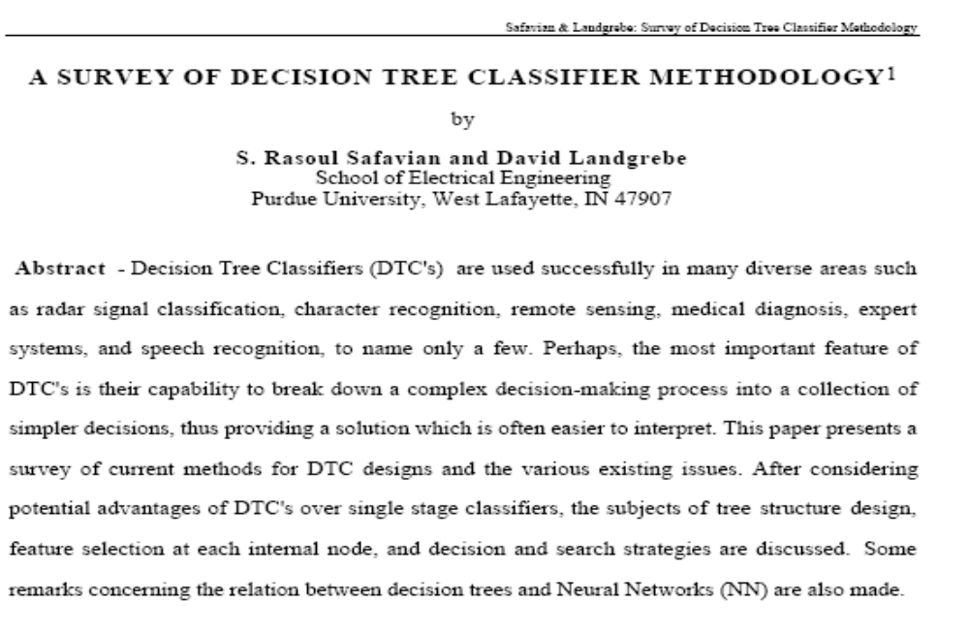
Decision Tree Classifiers : Survey paper

Slide 63
Classification in Large Databases
Classification—a classical problem extensively studied by statisticians and machine learning researchers
Scalability: Classifying data sets with millions of examples and hundreds of attributes with reasonable speed
Why decision tree induction in data mining?
  relatively faster learning speed (than other classification methods)
  convertible to simple and easy to understand classification rules
  can use SQL queries for accessing databases
  comparable classification accuracy with other methods
Data Mining: Concepts and Techniques

Slide 64
Constructing Classifier for B.I.
The leading Credit Card Company Visa International and Computer Company Acer Inc. has agreed to market the newly launched Laptop Computer.
For targeted marketing campaign, both the companies would like to use the existing database of Visa Credit card holders, to find out most likely buyers of their Computer.
For a given Database, your job will be to construct a Classifier.
This Classifier should take an input as the customer-details like
  Age,
  Income
  Student or Professional
  Credit_Card Ratings
And based on above inputs, the Classifier would Predict, whether the person is likely buyer of the Laptop Computer or not.

Slide 65
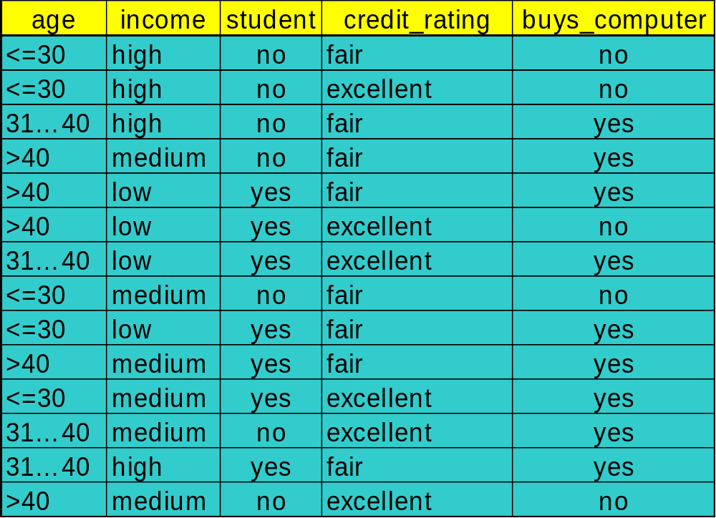
To construct Classifier from a given training data

Slide 66
Constructing Classifier
Data Domain Analysis
  Small Dataset with 04 discrete valued attributes.
  The Class label attributes are Boolean in nature!
    Class Labels:
      C1:buys_computer = ‘yes’
      C2:buys_computer = ‘no’
Predictive mechanism needed !
Business application with transactional database: no missing values !
Implementation details
  Execution of Java program with dataset.
  Constructing IF…. THEN… ELSE Rules.

Slide 67
DT induction: Issues
There are 04 attributes in the table, which attribute to start with at Root ?
  Attribute Selection measure or measure of goodness of split
    Select the attribute with the highest information gain
    Calculate information gain of each of 04 attributes by calculating;
      Expected information (entropy)
      Information needed
      Information Gained= (a)-(b)
    Find out the maximum I.G. out of attributes age, income, student, credit_rating

Slide 68




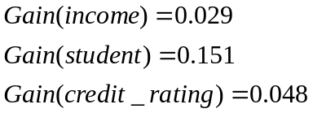
Attribute Selection: Information Gain
Class P: buys_computer = “yes”
Class N: buys_computer = “no”
means “age <=30” has 5 out of 14 samples, with 2 yes’es and 3 no’s. Hence
Similarly, Looking at other Gains, we can see the Gain(age) is max.
Data Mining: Concepts and Techniques

Slide 69

Gain Ratio for Attribute Selection (C4.5)
Information gain measure is biased towards attributes with a large number of values
C4.5 (a successor of ID3) uses gain ratio to overcome the problem (normalization to information gain)
  GainRatio(A) = Gain(A)/SplitInfo(A)
Ex.
  gain_ratio(income) = 0.029/0.926 = 0.031
The attribute with the maximum gain ratio is selected as the splitting attribute

Slide 70
Output: A Decision Tree for
“Buys_Computer”
age?
<=30
overcast
>40
31..40
Income | Student | Credit_rating | Class
High | No | Fair | no
High | No | excellent | no
medium | No | Fair | no
Income | Student | Credit_rating | Class
medium | No | Fair | yes
Income | Student | Credit_rating | Class
High | No | Fair | yes
Data Mining: Concepts and Techniques

Slide 71
Output: A Decision Tree for “buys_computer”
age?
<=30
overcast
>40
31..40
student?
yes
credit rating?
no
yes
excellent
fair
no
yes
no
yes
Data Mining: Concepts and Techniques

Slide 72
Constructing Classifier for B.I.
The leading Credit Card Company Visa International and Computer Company Acer Inc. has agreed to market the newly launched Laptop Computer.
For targeted marketing campaign, both the companies would like to use the existing database of Visa Credit card holders, to find out most likely buyers of their Computer.
For a given Database, your job will be to construct a Classifier.
This Classifier should take an input as the customer-details like
  Age,
  Income
  Student or Professional
  Credit_Card Ratings
And based on above inputs, the Classifier would Predict, whether the person is likely buyer of the Laptop Computer or not.
DTC was proposed as one of the alternative, but it showed some limitations.

Slide 73
Credit Card Database & BI application
As the Visa International has accumulated huge record of its Credit card holders for last 05 years amounting to terabytes of data.
Though larger the data better the training of the Classifiers ( some popularly used DTC algorithms C4.5 uses as much as 2/3 of the data for training the Classifiers).
In Case of our BI application, the problem starts with calculating Information Gain
    Every attributes involves all transactions for IG
    disk resident training data is not fitting into our memory for training activity.
    Scalability Problem!

Slide 74
Data Mining Software
Many providers of data mining software
  SAS Enterprise Miner, SPSS Clementine, Statistica Data Miner, MS SQL Server, Polyanalyst, KnowledgeSTUDIO, …
  See http://www.kdnuggets.com/software/suites.html for a list
  Good algorithms important, but also need good facilities for handling data and meta-data
We’ll use:
  WEKA (Waikato Environment for Knowledge Analysis)
    Free (GPLed) Java package with GUI
    Online at www.cs.waikato.ac.nz/ml/weka
    Witten and Frank, 2000. Data Mining: Practical Machine Learning Tools and Techniques with Java Implementations.
  R packages
    E.g. rpart, class, tree, nnet, cclust, deal, GeneSOM, knnTree, mlbench, randomForest, subselect

